Slide 1

DeepLAW

Slide 2

Imagine situation

Slide 3
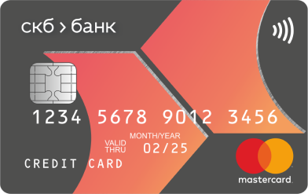
Imagine situation

Slide 4

Imagine situation

Slide 5

Imagine situation

Slide 6



Imagine situation
БАНК

Slide 7
Imagine situation

Slide 8

Imagine situation

Slide 9
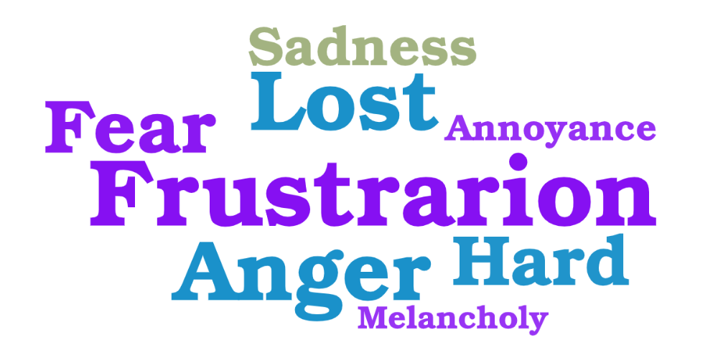
what would you feel

Slide 10


What is the problem

Slide 11

Questions People ask
“What can I do with old CD/DVD according to the law?”
“Am I denigrate the university if I’m telling my opinion?”
“Can I take a duck home from park?”
“Can I restrict my son from using the phone? Isn’t it his property?”
“Can I invite someone home if my co-owner doesn’t want it?”
. . .

Slide 12

WE HAVE THE SOLUTION!
Hello! My name is DeepLAW. I was created to serve people and help them with solving legal problems.

Slide 13
EASY TO USE
I have a problem with my card…
Here what the law says about your problem and what you should do next…

Slide 14

HOW TO ACHIEVE THIS
+
=
GPT-3

Slide 15


Multiple connections

Slide 16





Possible users

Slide 17
DeepLAW
IMPROVE THE WORLD TODAY

